Slide 1



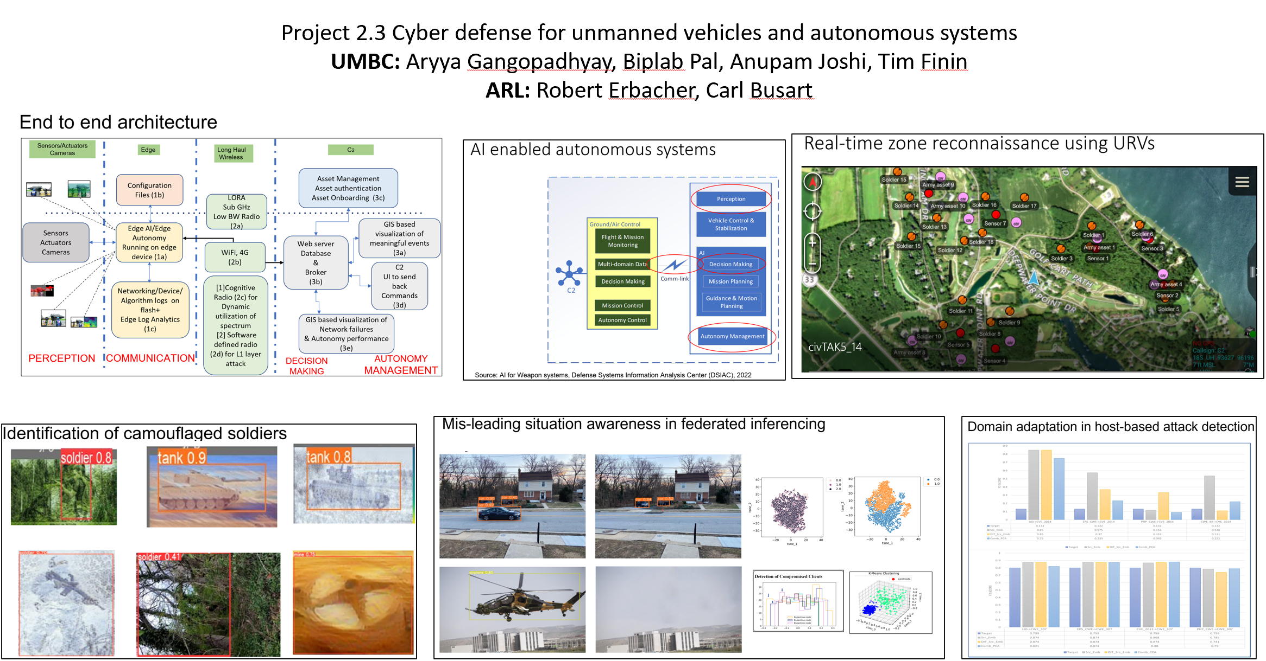
Securing Connected Vehicles, Soldiers, and Platforms in Contested Environments (CRA-4): Gangopadhyay, A. (UMBC), Busart C. (ARL)
This research is supported by U.S. Army Grant No. W911NF2120076
T

Slide 2
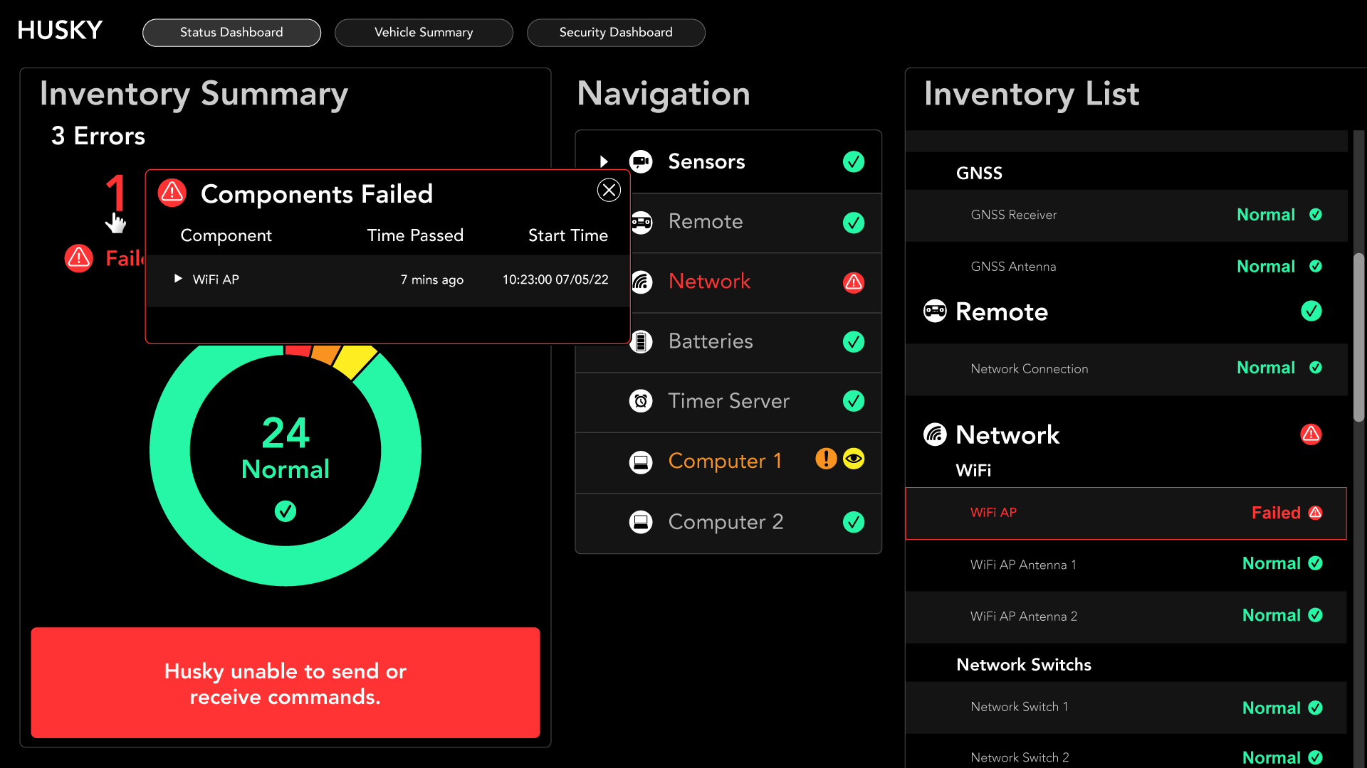
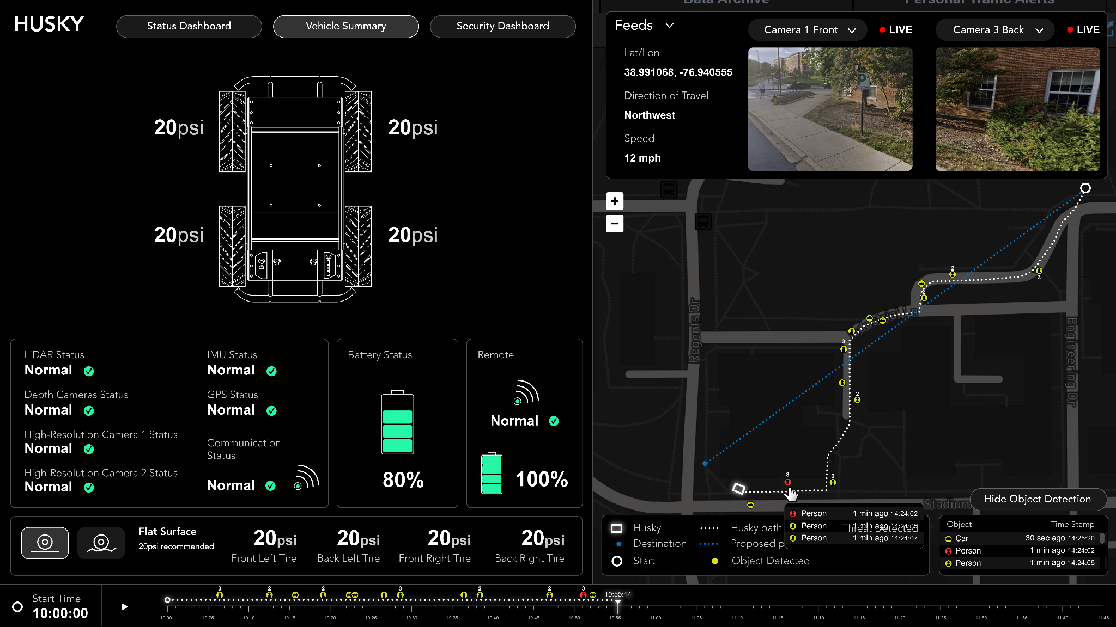
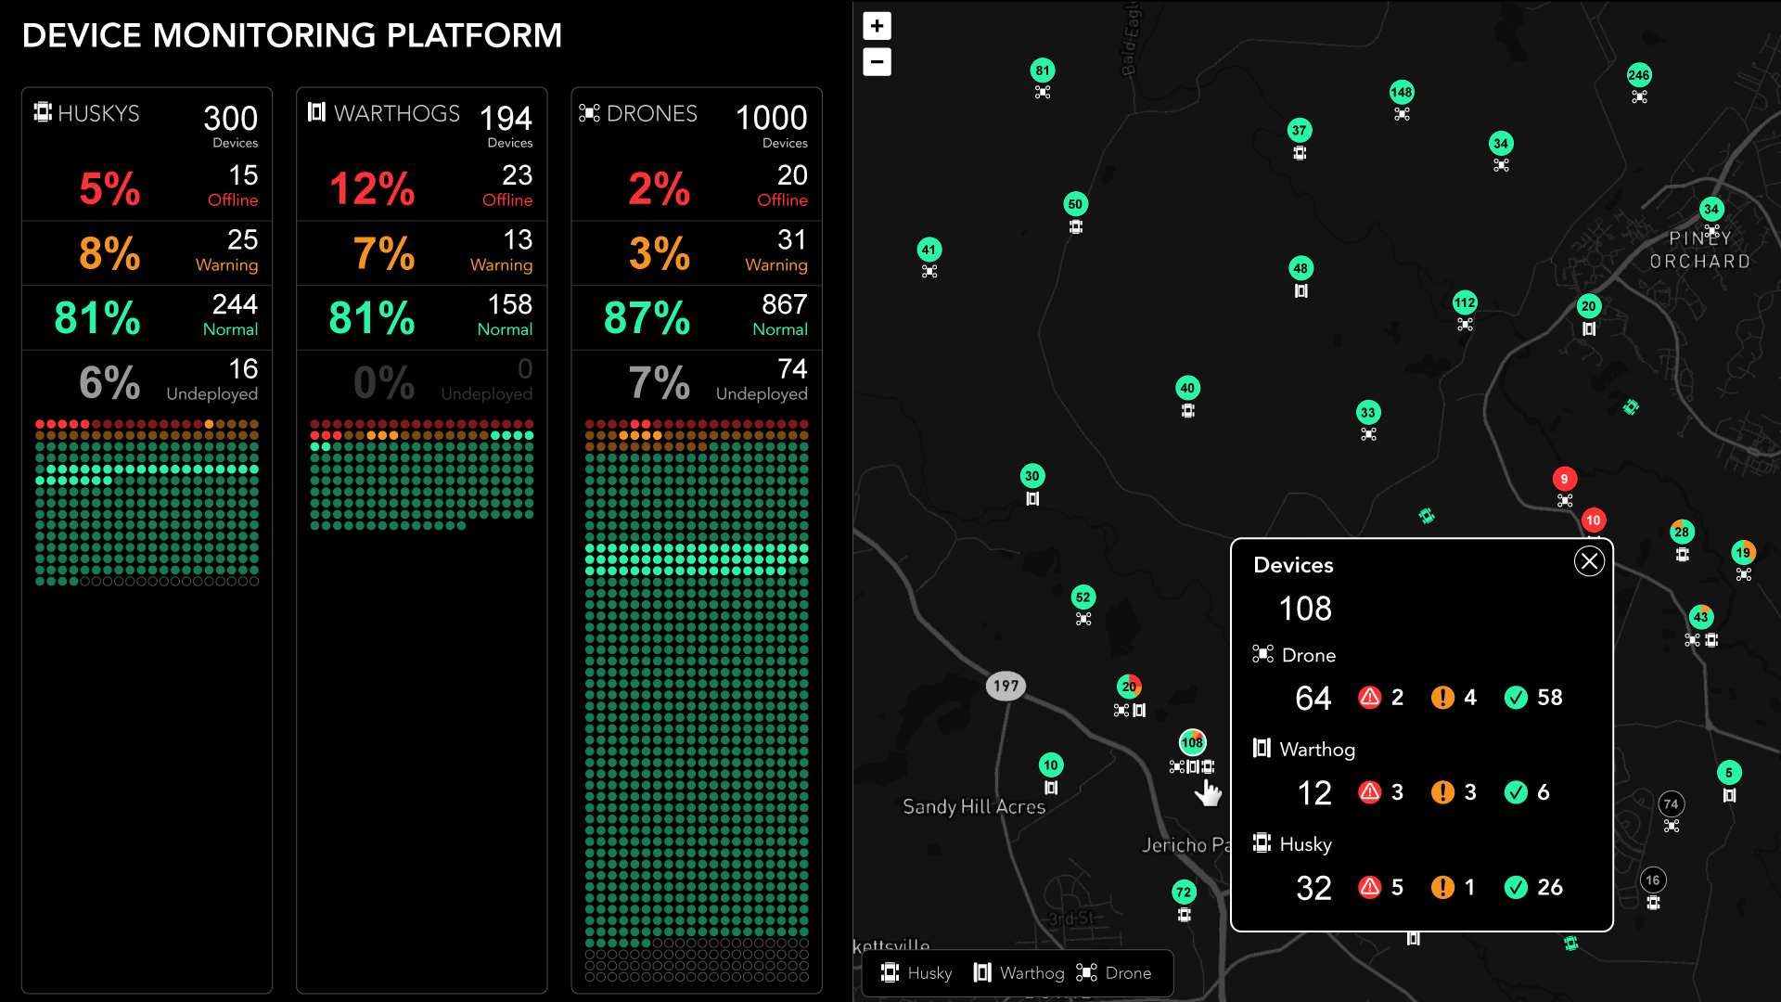
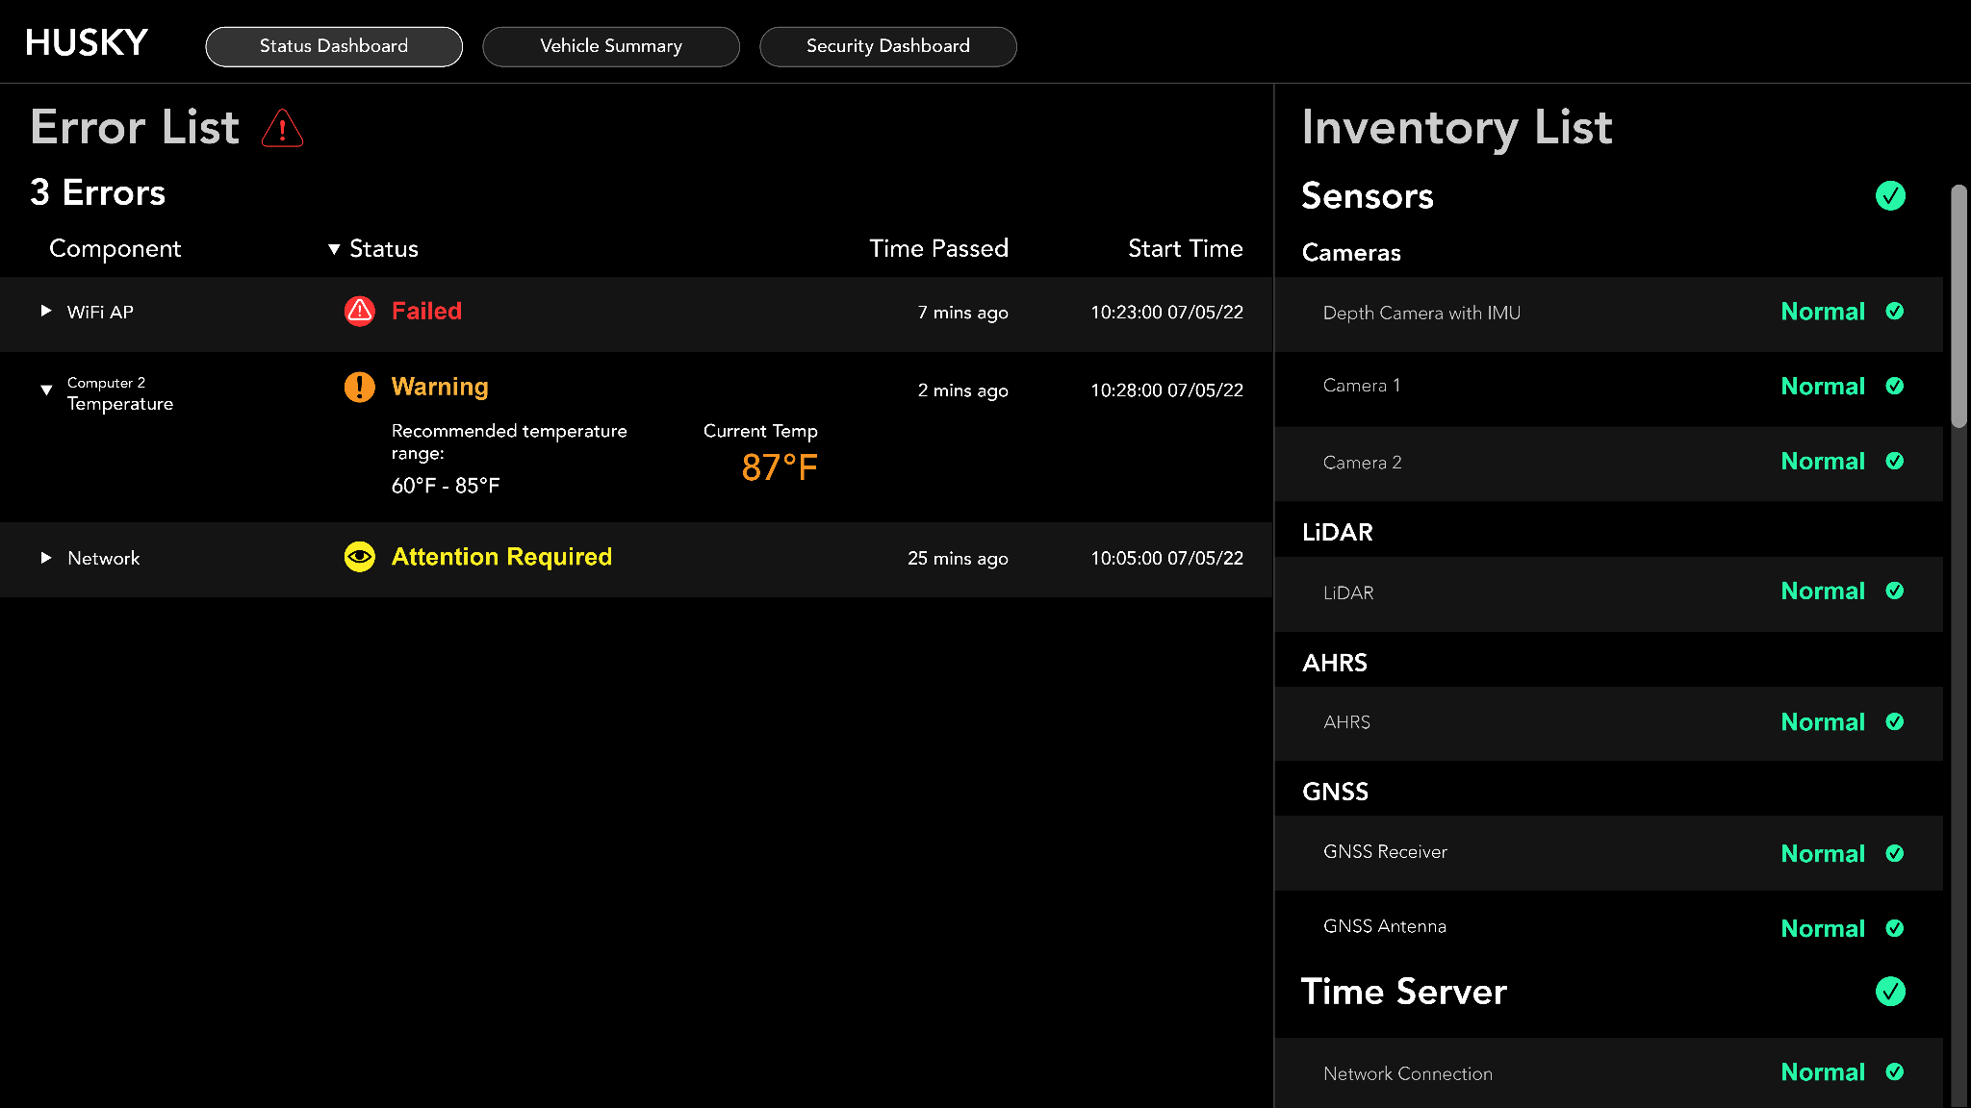
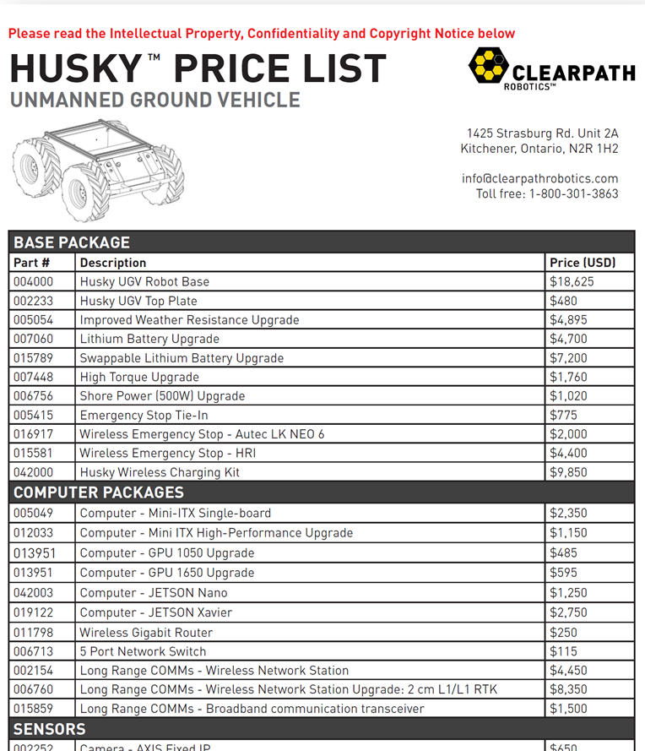
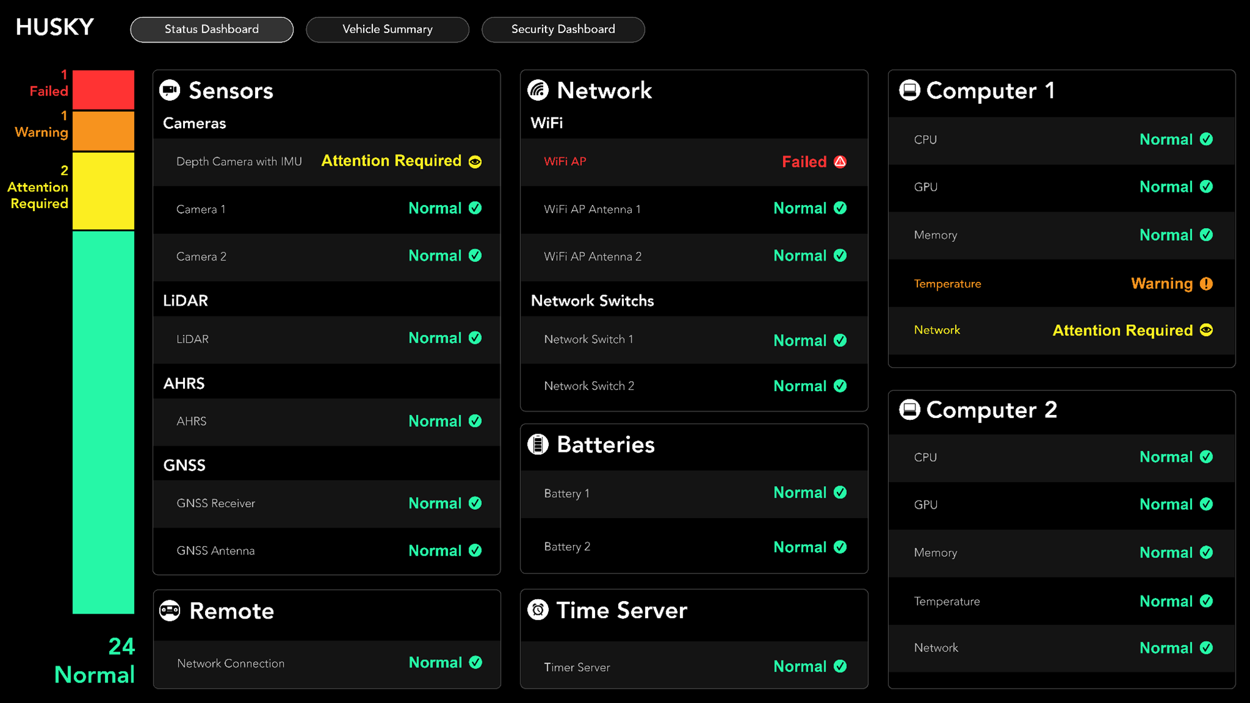
Securing Connected Vehicles, Soldiers, and Platforms in Contested Environments (CRA-4): Gangopadhyay, A. (UMBC), Busart C. (ARL)
This research is supported by U.S. Army Grant No. W911NF2120076
Project 2.9 Army Cyber-physical Systems & Logistics Data Analytics
UMCP: Michael Pack, Don Woodbury, Doug Warner
ARL: Jerry A Clarke, Frederica Free-Nelson, Stephen Raio, and Brian Panneton
Project Goal: Comprise a range of information specificities & user capabilities
Visualization Dashboard
T
Background cybersecurity visualization research
most general information
UI/UX designs of real-time data & forensic info visualization
Initial UI mockups
most specific information
Platform Selection & Acquisition
Procuring Husky

Slide 3
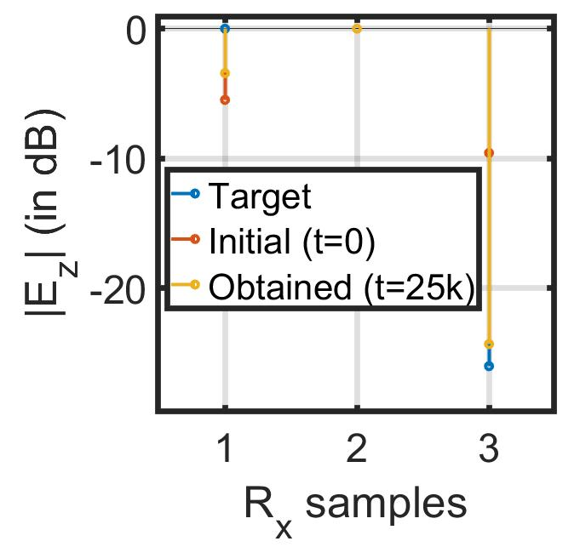
Securing Connected Vehicles, Soldiers, and Platforms in Contested Environments (CRA-4): Gangopadhyay, A. (UMBC), Busart C. (ARL)
This research is supported by U.S. Army Grant No. W911NF2120076
Project 2.9 Army Cyber-physical Systems & Logistics Data Analytics
1.6: Distributed Robotic Beamforming
K. Chakrabarti, A. S. Bedi, N. Chopra (UMD),
F. T. Dagefu, J. N. Twigg (ARL)
UMCP: Michael Pack, Don Woodbury, Doug Warner
ARL: Jerry A Clarke, Frederica Free-Nelson, Stephen Raio, and Brian Panneton
Project Goal: Comprise a range of information specificities & user capabilities
Visualization Dashboard
Objective: Autonomous multi-robots collaboratively form an antenna array to transmit a high-power directed signal while steering nulls through precise control of interference.
Acceleration due to the proposed IPG-DB algorithm enables rapid establishment of communication links.
T
Background cybersecurity visualization research
most general information
UI/UX designs of real-time data & forensic info visualization
Initial UI mockups
most specific information
Tested in a simulated urban environment of Los Angeles using 6 Tx, 2 target Rx, and 1 adversary.
Platform Selection & Acquisition
Self-configuring IPG-DB algorithm controls Tx phase+amplitude for covert directional communication without Rx feedback.
Procuring Husky
~40% faster than traditional gradient-descent algorithm

